Slide 1
Early Literacy Project Overview
Presented by: UCSD EDS Department Partners At Learning (PAL) Program

Slide 2
Students with below-average reading skills who are tutored by volunteers show significant gains in reading skills when compared with similar students who do not receive tutoring from a high-quality tutoring program
-US Department of Education
Notes:
US Department of Education

Slide 3
Learning to Read vs. Reading to Learn
By the time students reach third grade, difficulties in reading are a predictor for difficulties later on in academic performance
Before third grade: curriculum has time allocated to learn to read
After third grade: curriculum centered around reading to learn new content

Slide 4
Link to PAL Orientation Video https://www.youtube.com/watch?v=uUaFo2xp3AA
Notes:
https://www.youtube.com/watch?v=uUaFo2xp3AA

Slide 5
Partners At Learning (PAL)
Partners At Learning (PAL) is a UCSD program under the EDS department that pairs undergraduate students with P-12 underserved schools.
This Literacy Project aims to help early elementary students with their literacy skills through the PAL program.

Slide 6
Tutoring Overview
Pairing college tutors with early elementary who are reading at below-grade level
Getting to know the student
Assessing using the Developmental Reading Assessment (DRA)
One-on-One tutoring sessions using the Reading Recovery Model
HELP A KID READ!!! :)

Slide 7
Step 1 & 2: Pairing with and Getting to Know the students
Get to know the student by working with the class
Get info from the teacher about the student
Reading level
Personality
Reading habits

Slide 8
Step 3: Background on the Developmental Reading Assessment (DRA)
What is the DRA?
It is an assessment that helps better pinpoint the student’s reading level and target skills
Levels of the DRA (Most students we work with will fall in K-1st reading level)
Kinder-1st : A-L16
2nd: L18-L30
3rd: L30+

Slide 9
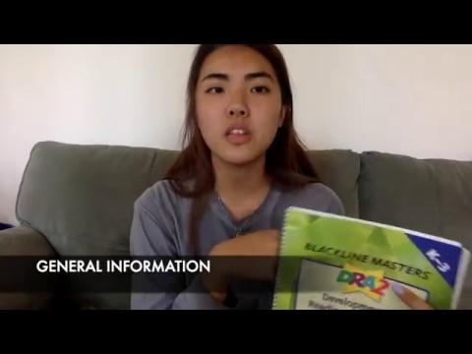
DRA WALKTHROUGH
Notes:
Video on DRA walkthrough

Slide 10
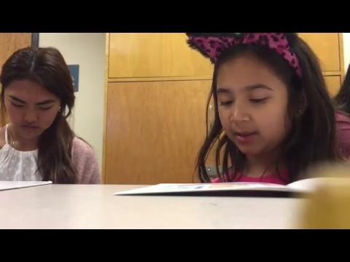
ADMINISTERING THE DRA
Notes:
Example of DRA being administered

Slide 11
Step 3: Applying the DRA to Tutoring
After administering the DRA, use your notes and judgement to fill out the continuum
The area in which the child falls below the Independent level will be the skills to target during the one-on-one sessions

Slide 12
Step 4: One-on-One Sessions
Each Session is broken down into 3 10-minute parts
Part 1 (10 minutes): Reading a familiar book
Find and read a book that the student has read before (bookbag, library, classroom)
Make sure this is a book that the student is familiar with and can read independently

Slide 13
Step 4: One-on-One Sessions
Part 2 (10 minutes): Reading a new book
Using the assessed DRA reading level to find an appropriate book for the student to read
When reading, write down a list of vocabulary that the student may be struggling with
New book will become the familiar book for the next session

Slide 14
Step 4: One-on-One Sessions
Part 3 (10 minutes): Comprehension Practice
After reading the new book, have the student write a sentence or two about the storyline for comprehension practice
Encourage the student to use words from the list of vocabularies made in Part 2
After dismissing the student, record information from the session
Be specific

Slide 15
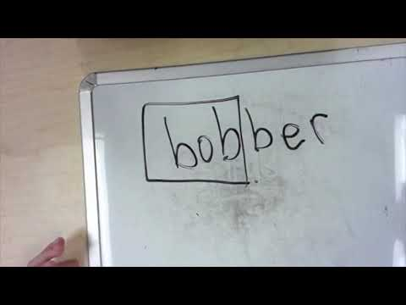
READING RECOVERY MODEL
Notes:
Video on one-on-one session

Slide 16
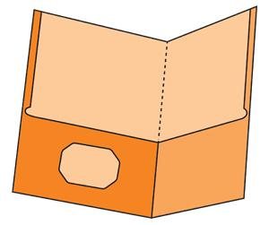
One-on-One Session Folders
Each student will have an assigned folder
The folders include the following:
Entry Log (to record each tutoring session) with: date, name of familiar book, name of new book, list of vocab
Notes: Be specific about what exactly the student struggled with during the session
Reading Level Chart (to convert DRA levels to Letter levels used at the school for book selection)
Reading Strategies packet (can be cut and used as bookmarks depending on what the student needs to work on)
Lined Papers (for writing activity in Part 3)
NOTE: Please keep all the tutoring materials and records inside the folder for each student.

Slide 17
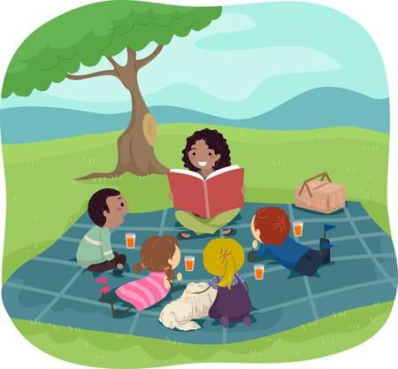
Tips From Tutors: Strategies You Might Want to Try
Before reading
Reviewing the alphabet and what sound each letter makes
Reviewing digraphs
Sh, ch, th
After Reading
Reviewing vocabulary words
Writing
Talking about what we are going to write before hand
If a student asks how to spell a word, have them try it first
If a student feels stuck when writing (what do I write next?) asking them to reiterate what we brainstormed before hand
Once a student finishes writing the sentence, asking them to read their sentences to you.
Reminders about Sentence structure
When you write a sentence, what do you have to make sure your first word is?
Capital letter
What do you put at the end of a sentence?
Punctuation mark--periods, question marks, exclamation points

Slide 18
Thank you and Go do WONDERFUL things!!!!!

